Slide 1
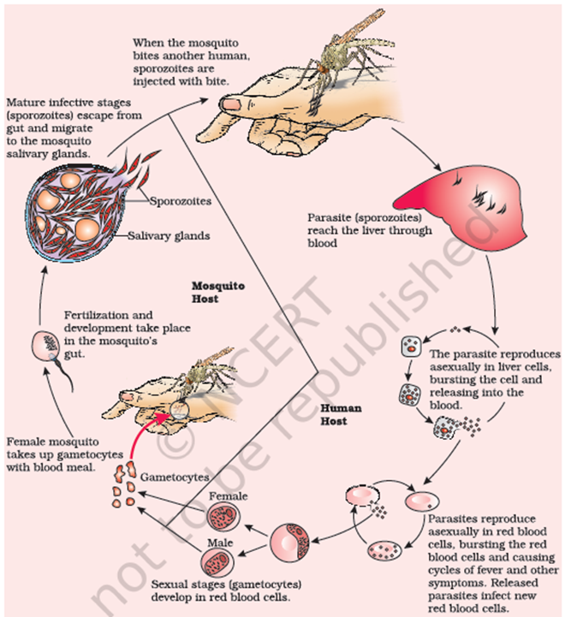
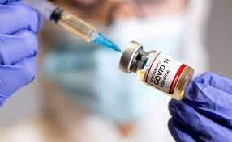
Biology for Engineers Course Code:21BE45
MODULE 2:
Common Diseases and Vaccination - Allergies, Colds and Flu - causes and precautions.
First vaccine in the world, Vaccine for Rabies and RNA vaccines for Covid- critical
analysis, case study of process of development of covid vaccine.
Forensics – DNA fingerprinting. Engineering solutions for Parkinson’s disease. Heart disease and its types.
Modern technologies to detect heart diseases.

Slide 2
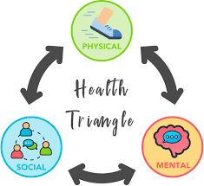
What is Health?
Health is a state of complete physical mental and social well-being. It's not only the absence of disease.​
A person is said to be healthy when he/she is free of any type of disease (infectious/deficiency) when he/she is mentally happy and healthy, and when his/her social relationships are healthy in society.
Hence, to have a healthy life one has to be physically, mentally, and socially complete.

Slide 3
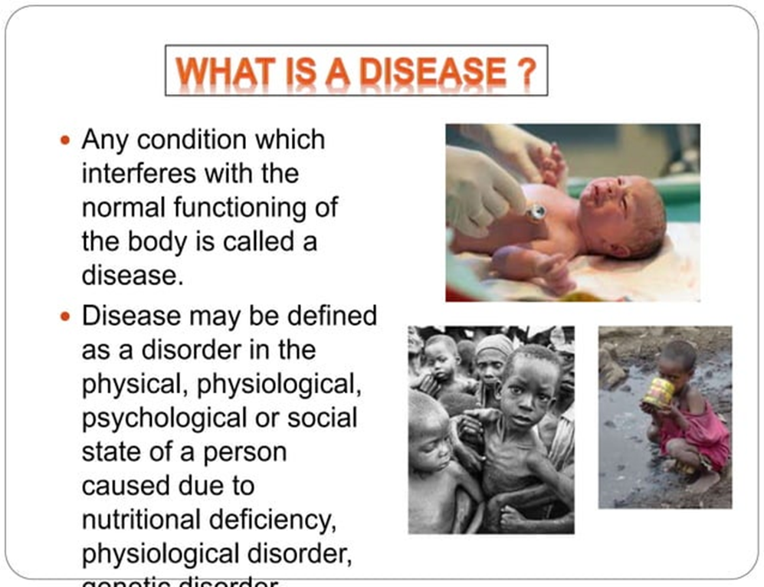

Slide 4
What is difference between infectious and non-infectious diseases?
Diseases can be broadly differentiated into infectious and non-infectious diseases. Diseases that are easily transmitted from one person to another are known as infectious diseases, whereas diseases that remain confined to a person are known as non-infectious diseases.
Non-infectious diseases, including heart disease, stroke, cancer, diabetes and chronic lung disease, are collectively responsible for 74% of all deaths worldwide
What are the types of infectious diseases?
Viral infections. Viruses are a piece of information (DNA or RNA) inside of a protective shell (capsid). ...
Bacterial infections. ...
Fungal infections. ...
Parasitic infections. ...
Transmissible spongiform encephalopathies (TSEs/prion diseases).

Slide 5
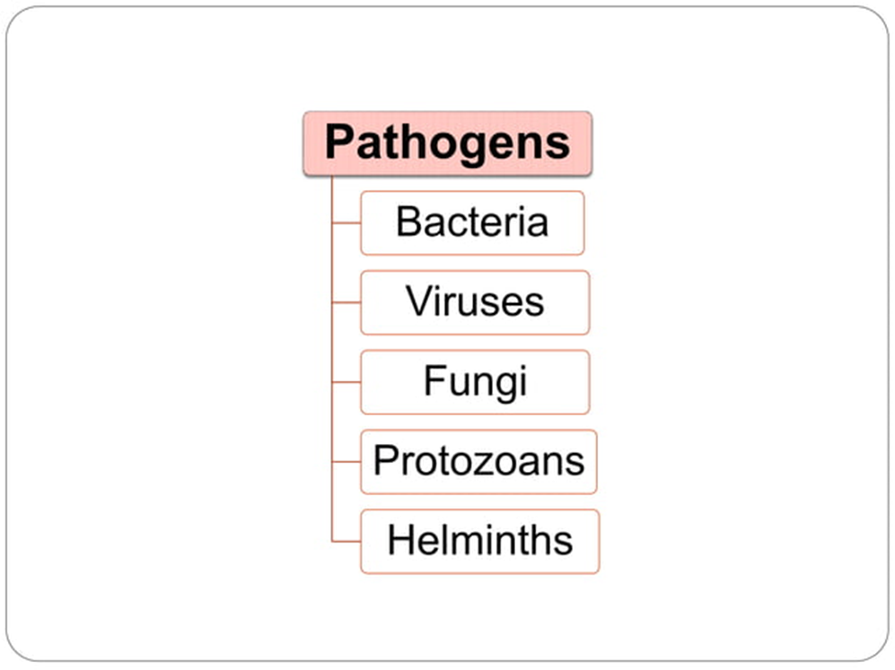

Slide 6
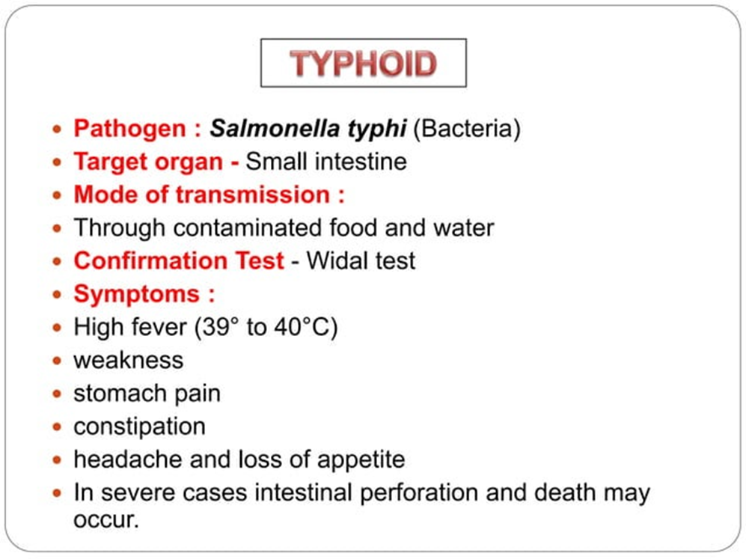

Slide 7
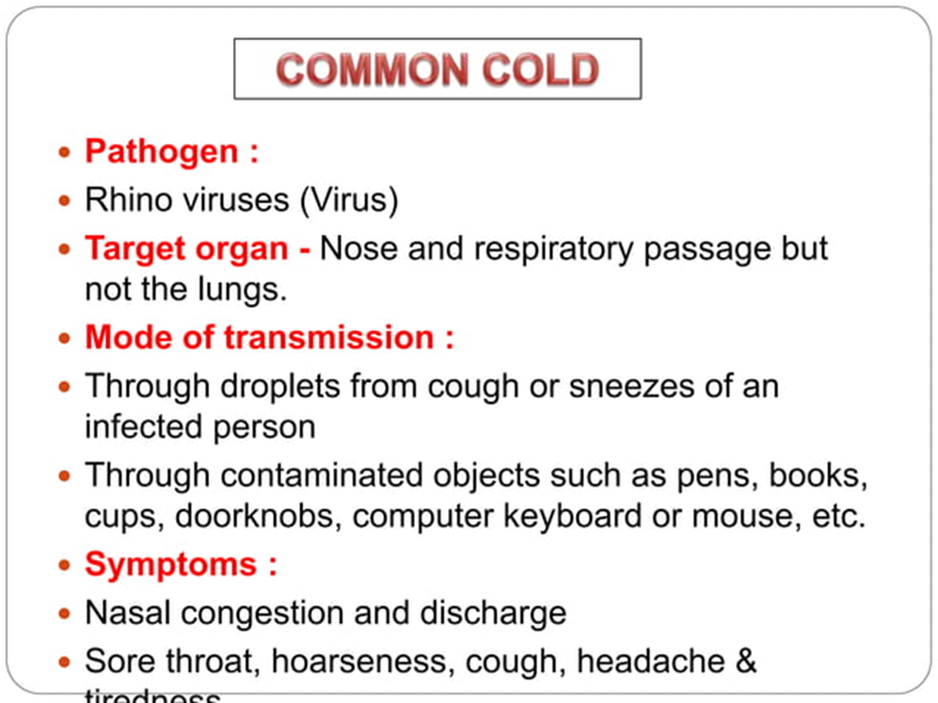

Slide 8
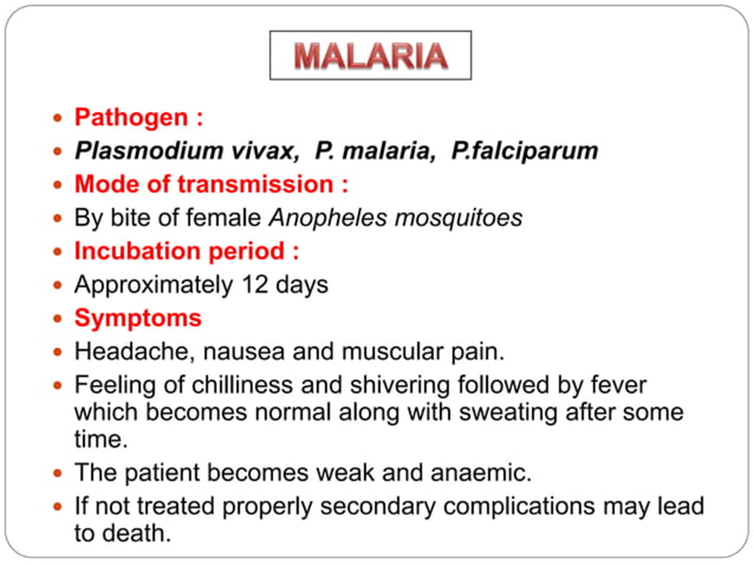
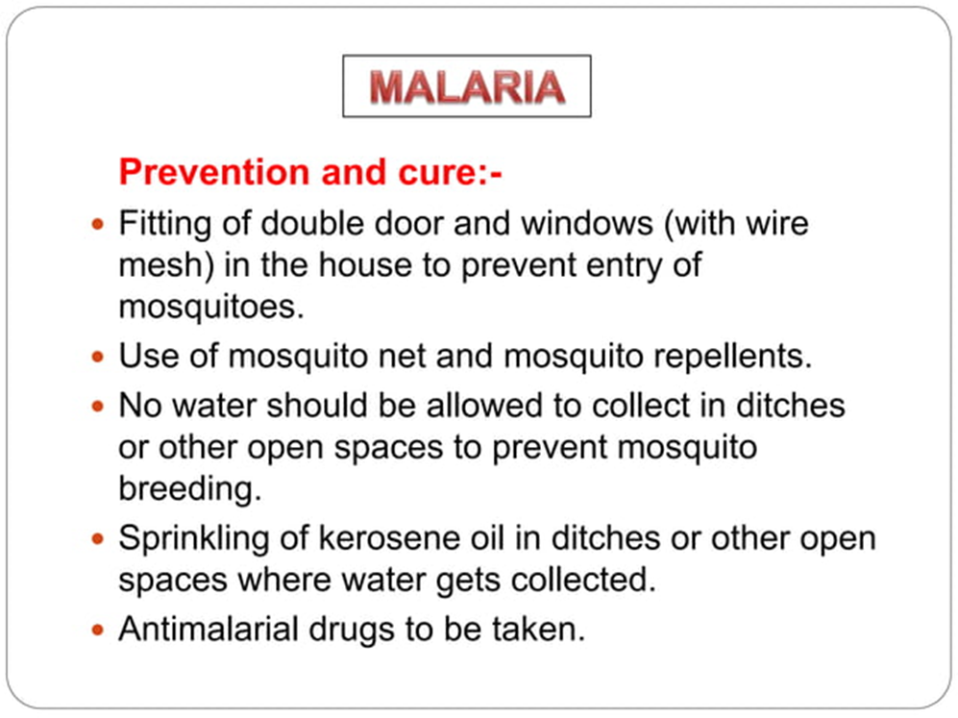

Slide 9
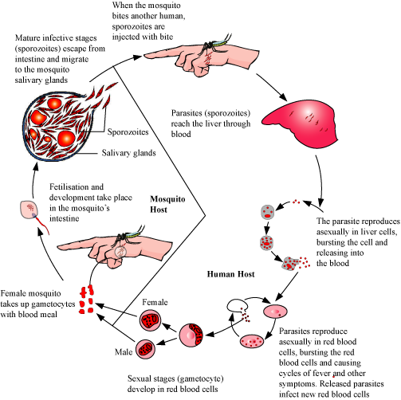

Slide 10
ALLERGIES
What do you mean by allergy?
Allergy occurs when a person reacts to substances in the environment that are harmless to most people. These substances are known as allergens. Allergens are found in dust mites, pets, pollen, insects, ticks, moulds, foods and some medications. What are the 7 allergy symptoms?
Symptoms of an Allergic Reaction
Itchy, watery eyes.
Itchy nose.
Sneezing.
Runny nose.
Rashes.
Hives (a rash with raised red patches)
Stomach cramps.
Vomiting.

Slide 11
Which areas of the body may be affected?
People experience different symptoms, depending on the allergen and where it enters the body. Allergic reactions can involve many parts of the body at the same time.
Nose, eyes, sinuses and throat
When allergens are breathed in, the release of histamine causes the lining of the nose to produce more mucus and become swollen and inflamed. It causes the nose to run and itch, and violent sneezing may occur. Eyes may start to water and people may get a sore throat.
Lungs and chest
Asthma can be triggered during an allergic reaction. When an allergen is breathed in, the lining of the passages in the lungs swells and makes breathing difficult.
Stomach and bowel
Foods that commonly cause allergy include peanuts, seafood, dairy products and eggs. Cow's milk allergy in infants may occur and can cause eczema, asthma, colic and stomach upset. Some people cannot digest lactose (milk sugar). Lactose intolerance causes stomach upsets, but should not be confused with allergy.
Skin
Skin problems that can be triggered by allergy include atopic dermatitis (eczema) and urticaria (hives).

Slide 12
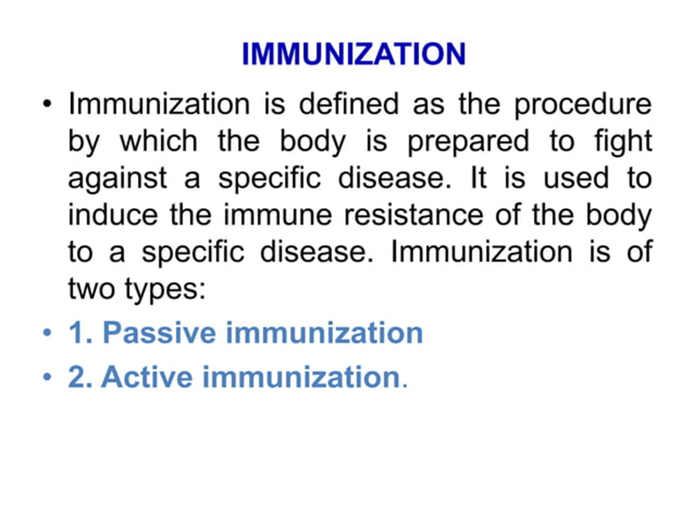

Slide 13
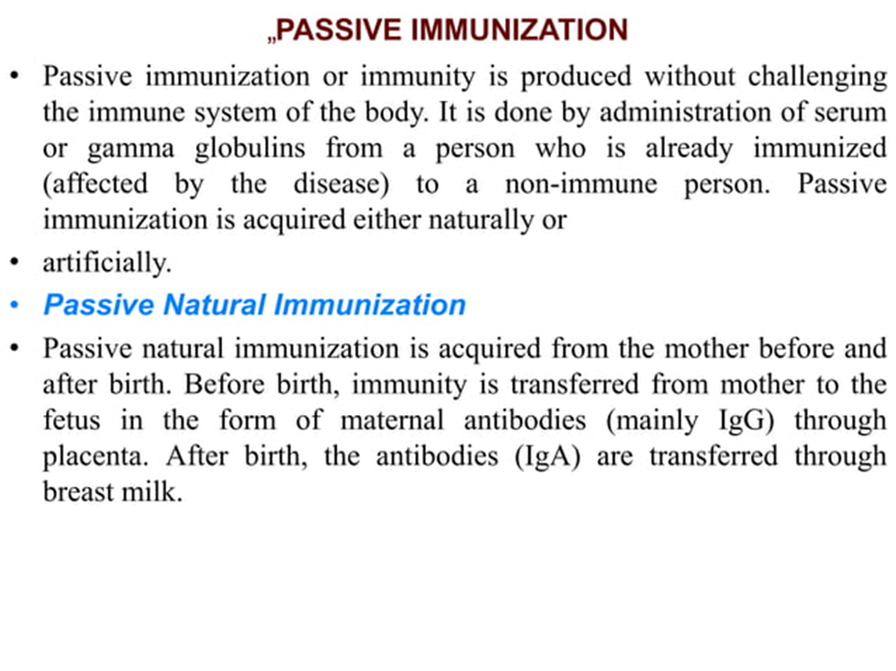

Slide 14
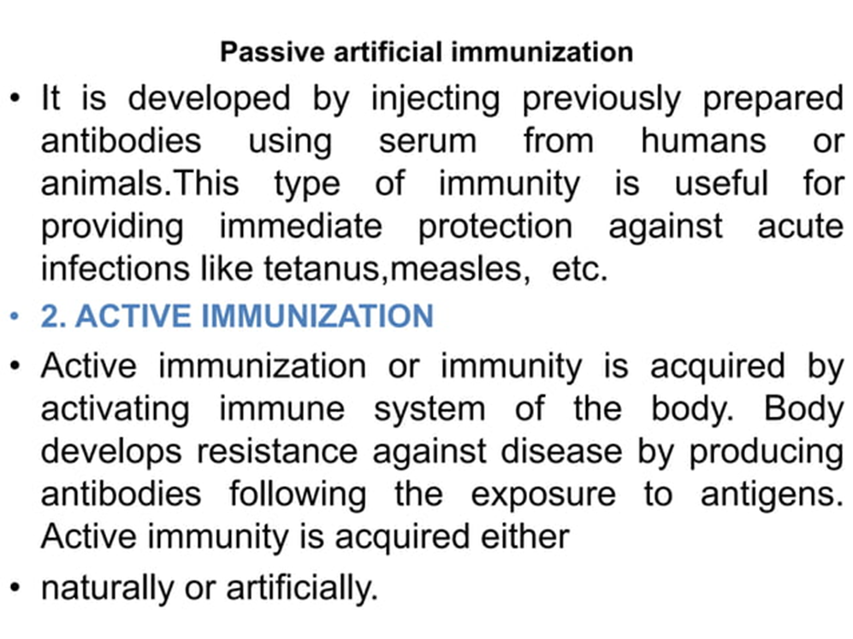

Slide 15
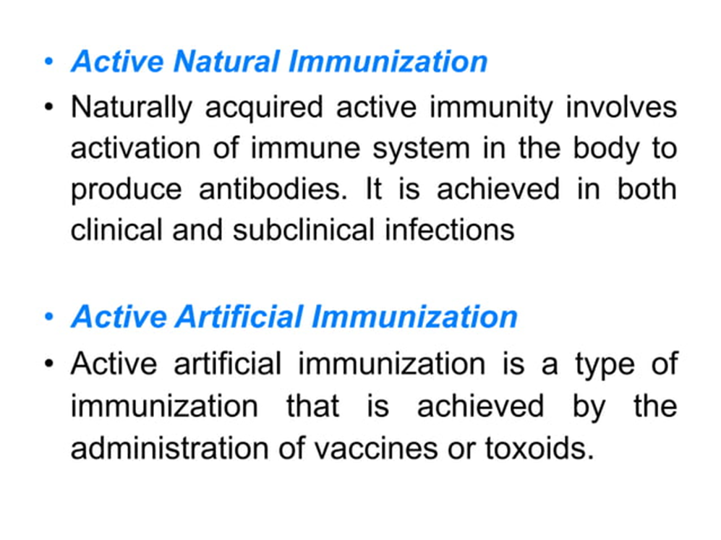

Slide 16
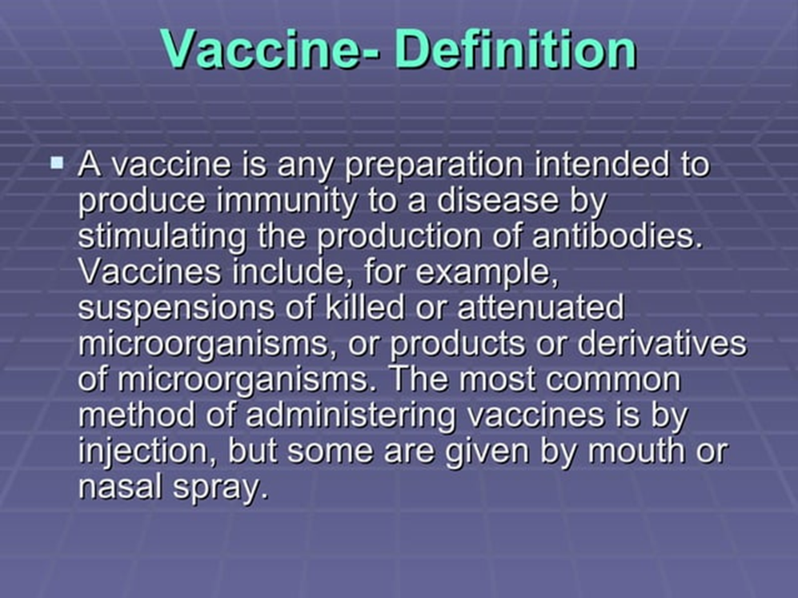

Slide 17
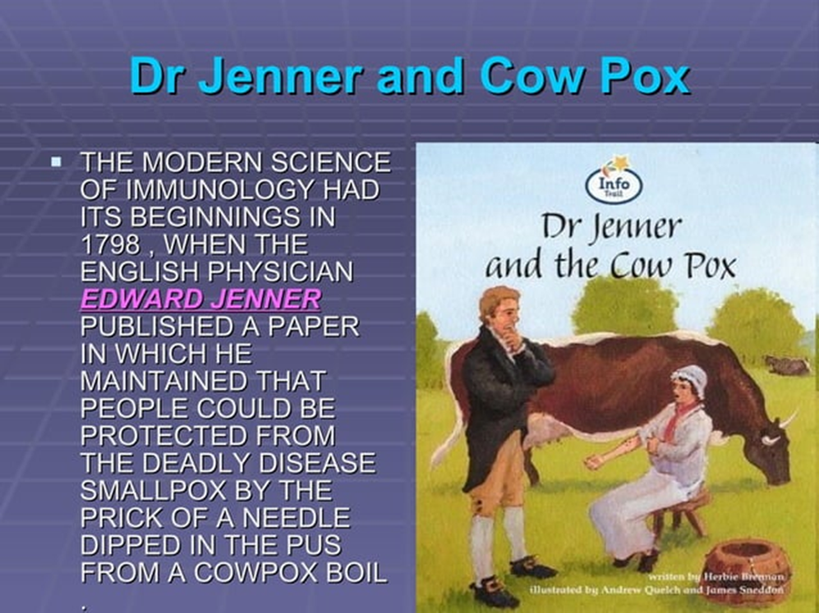
First vaccine in the world The basis for vaccination began in 1796 when the English doctor Edward Jenner noticed that milkmaids who had gotten cowpox were protected from smallpox. Jenner also knew about variolation and guessed that exposure to cowpox could be used to protect against smallpox The smallpox vaccine, introduced by Edward Jenner in 1796, was the first successful vaccine to be developed.

Slide 18
what are the 5 types of vaccines?
Inactivated vaccines.
Live-attenuated vaccines.
Messenger RNA (mRNA) vaccines.
Subunit, recombinant, polysaccharide, and conjugate vaccines.
Toxoid vaccines.
Viral vector vaccines.

Slide 19
Vaccination for Rabies
On July 6, 1885, Louis Pasteur and his colleagues injected the first of 14 daily doses of rabbit spinal cord suspensions containing progressively inactivated rabies virus into 9-year-old Joseph Meister, who had been severely bitten by a rabid dog 2 days before.
The method involved developing a consistent source of virulent virus by taking pieces of spinal cord from a rabid street dog and inoculating by trepanation under the dura mater (dura) into the cranium of a rabbit, and then passing it from rabbit to rabbit 20–25 times until the virus was consistently virulent. When Pasteur had established a way to obtain rabbits with spinal cord material that was consistently virulent, he took pieces of the spinal cord, each a few centimeters long, and exposed them to dry air. The exposure to dry air, gradually decreased the virulence until it totally disappeared.
Pasteur had inoculated approximately 50 dogs with a suspension of the dehydrated spinal cord and he had observed that the dogs had become refractory to the inoculation with virulent rabid spinal material, when on Monday, July 6, 1885, three people arrived from Alsace. One of them was Joseph Meister, a nine-year-old boy who had been bitten by a dog at 8:00 AM on July 4. The boy had at least 14 bites and his death from rabies seemed inevitable.
Using the experience he had already with the 50 dogs, on the evening of July 6, together with Dr. Vulpian and Dr. Grancher ,Pasteur inoculated the boy with material from a rabid rabbit spinal cord that had been dehydrated for 15 days. Pasteur concluded that the boy had survived the rabies from the bites of a rabid dog.

Slide 20
RNA VACCINES FOR COVID-19:
Coronavirus disease (COVID-19) is an infectious disease caused by the SARS-CoV-2 virus. Messenger RNA, or mRNA technology, instructs cells to make a protein that generates an immune response in the body, thus producing the antibodies that provide protection against a disease.

Slide 21
It is the basis for the Pfizer/BioNTech and Moderna COVID-19 vaccines being used by governments worldwide, and in the UN-supported COVAX global vaccine solidarity initiative. Messenger ribonucleic acid (mRNA) is a molecule that provides cells with instructions for making proteins. mRNA vaccines contain the instructions for making the SARS-CoV-2 spike protein. This protein is found on the surface of the virus that causes COVID-19.

Slide 22
The mRNA molecule is essentially a recipe, telling the cells of the body how to make the spike protein. COVID-19 mRNA vaccines are given by injection, usually into the muscle of the upper arm. After the protein piece is made, the cell breaks down the instructions and gets rid of them. The mRNA never enters the central part (nucleus) of the cell, which is where our DNA (genetic material) is found. Your DNA can't be altered by mRNA vaccines.
The cell then displays the protein piece on its surface. Our immune system recognizes that the protein doesn't belong there and begins building an immune response and making antibodies.

Slide 23
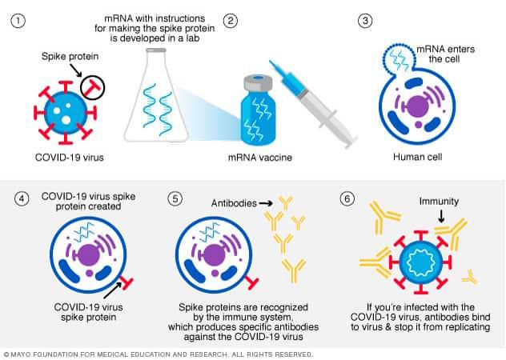

Slide 24
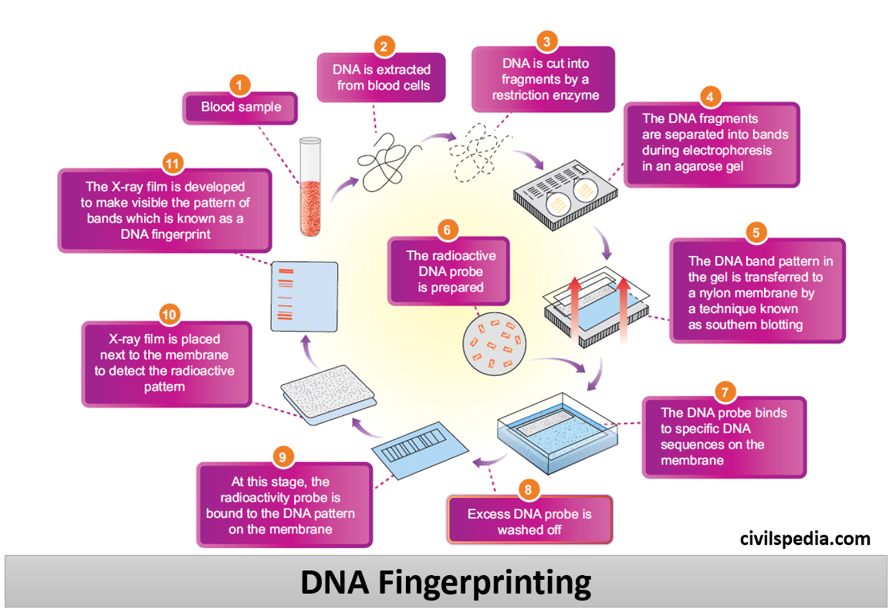

Slide 25
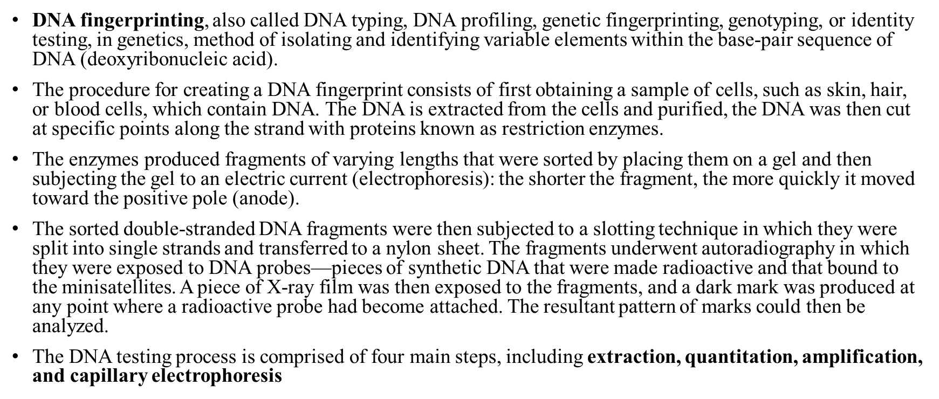
DNA Fingerprinting

Slide 26
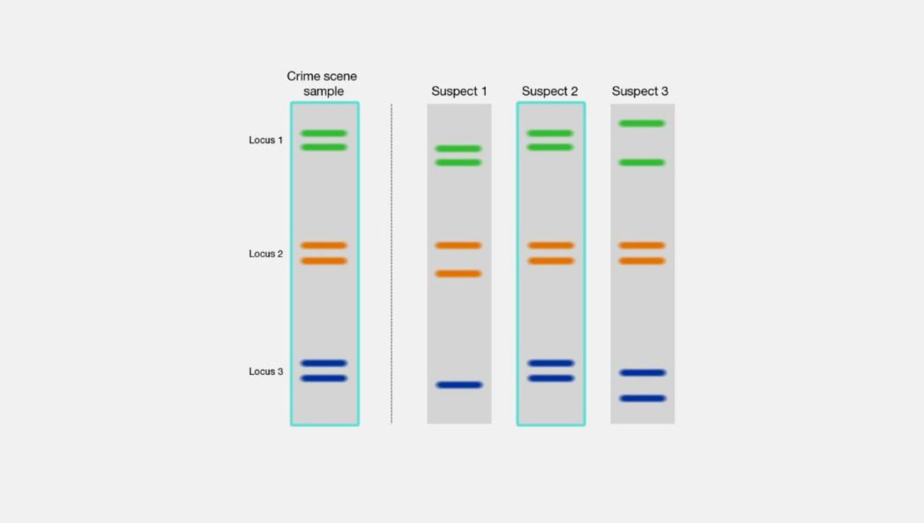

Slide 27
Parkinson's disease is a progressive disorder that affects the nervous system and the parts of the
body controlled by the nerves. Symptoms start slowly. The first symptom may be a barely
noticeable tremor in just one hand. Tremors are common, but the disorder may also cause stiffness
or slowing of movement.
In Parkinson's disease, certain nerve cells (neurons) in the brain gradually break down or die. Many of the symptoms are due to a loss of neurons that produce a chemical messenger in your brain called dopamine. When dopamine levels decrease, it causes atypical brain activity, leading to
impaired movement and other symptoms of Parkinson's disease.
Parkinson's disease can't be cured, but medications can help control the symptoms, often
dramatically. In some more advanced cases, surgery may be advised. Your health care provider
may also recommend lifestyle changes, especially ongoing aerobic exercise.

Slide 28
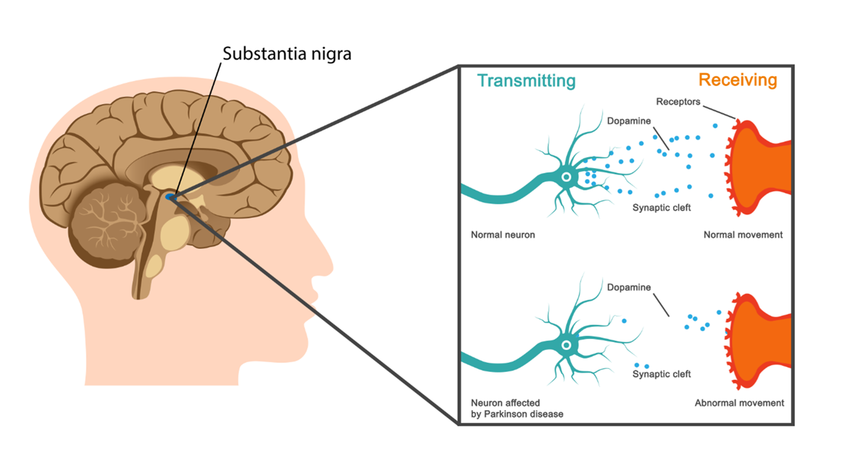

Slide 29
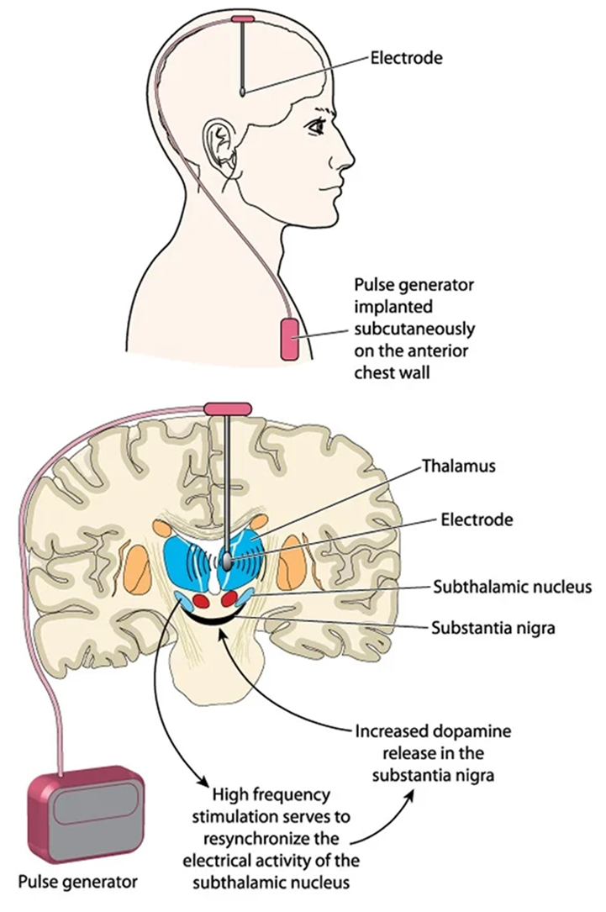
ENGINEERING SOLUTIONS TO THIS DISEASE ARE:
Deep Brain Stimulation – Deep Brain Stimulation (DBS) involves surgically implanting a neurotransmitter that sends electrical impulses to specific areas of your brain. This procedure has helped many people with Parkinson's reduce symptoms such as tremor, rigidity, and bradykinesia. There are six main types of medications available to treat symptoms of Parkinson disease: levodopa, dopamine agonists, and inhibitors of enzymes that inactivate dopamine (monoamine oxidase type B [MAO B] inhibitors and catechol-O-methyl transferase [COMT] inhibitors, anticholinergic drugs, and amantadine.

Slide 30
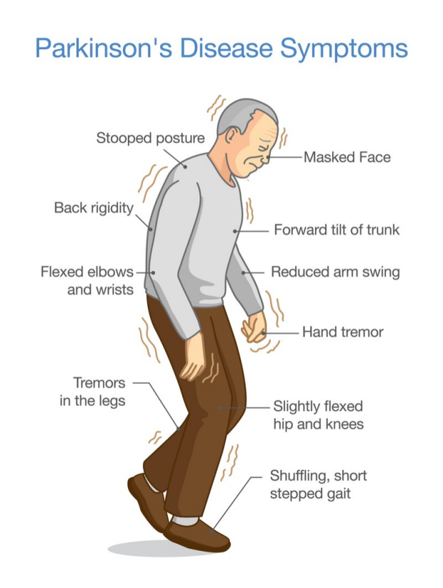

Slide 31
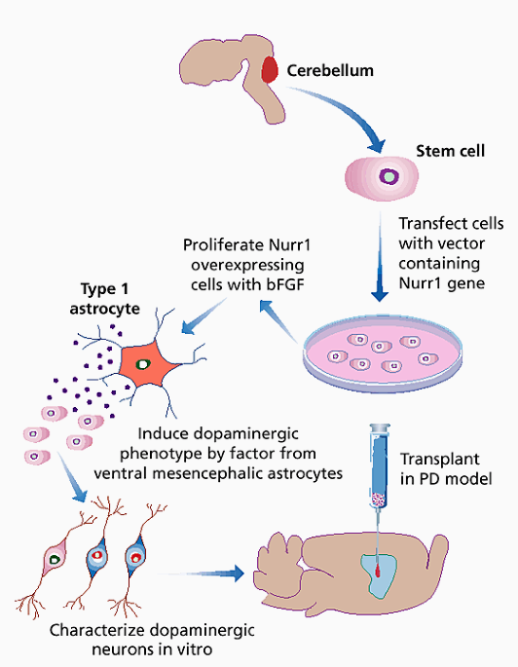
ENGINEERING NEURONS are another treatment method for this. Transplantation of embryonic neurons can restore functional dopaminergic neurons in the brains of patients with Parkinson's disease. But while promising, cell transplantation therapy is still out of reach to most patients, in part because of the inaccessibility of human embryonic tissue.
First obtained neuronal stem cells from mouse cells transfected with a transcription factor that encourages cells to adopt a neuronal fate. They then co-cultured the cells with astrocytes, which release a factor that induces development into dopaminergic neurons. The engineered cells released dopamine, and some maintained the characteristics of dopaminergic neurons for up to two weeks after implantation into mouse brains

Slide 32
Nurr1 is involved in the establishment and maintenance of the dopaminergic phenotype within specific central nervous system neuronal subpopulations including the nigrostriatal dopamine system. This protein is reduced over the course of normal aging, which is a major risk factor for Parkinson's disease (PD).
Basic Fibroblast Growth Factor - Basic fibroblast growth factor (bFGF) is an important member of a heparin-binding protein family, which controls the proliferation, differentiation, and migration of a variety of cell types of mesodermal and neuroectodermal origin.
Astrocyte- a large, star-shaped cell that holds nerve cells in place and helps them develop and work the way they should. An astrocyte is a type of glial cell.

Slide 33
Heart Diseases(Cardiovascular disease)
Cardiovascular disease (CVD) is a general term that describes a disease of the heart or blood vessels.
Blood flow to the heart, brain or body can be reduced because of a:
blood clot (thrombosis)
build-up of fatty deposits inside an artery, leading to the artery hardening and narrowing (atherosclerosis)
Types of CVD
There are four main types of CVD:
coronary heart disease
stroke
peripheral arterial disease
aortic disease

Slide 34
Coronary heart disease
Coronary heart disease (CHD) occurs when your heart muscle's blood supply is blocked or interrupted by a build-up of fatty substances (atheroma) in the coronary arteries.
The coronary arteries are the major blood vessels that supply your heart with blood.
If your coronary arteries become narrow due to a build-up of atheroma, the blood supply to your heart muscle will be restricted. This can cause angina (chest pains).
If a coronary artery becomes completely blocked, it can cause a heart attack. This is a medical emergency.

Slide 35
Stroke
A stroke is a serious medical condition that occurs when the blood supply to the brain is disturbed.
Like all organs, your brain needs a constant supply of oxygen and nutrients to function properly. This is provided by the blood, so if your blood flow is restricted or stopped, brain cells will begin to die. This can lead to brain damage and possibly death.
Therefore, a stroke is a medical emergency and prompt treatment is essential. The sooner a person receives treatment, the less damage is likely to occur.

Slide 36
The main stroke symptoms can be remembered with the word FAST which stands for:
Face – the face may have drooped on one side, the person may not be able to smile or their mouth or eye may have drooped
Arms – the person with suspected stroke may not be able to lift their arm and keep it raised due to weakness or numbness
Speech – the person's speech may be slurred or garbled, or they may not be able to talk at all despite appearing to be awake
Time – it is time to dial 997immediately if you see any of these signs or symptoms

Slide 37
Peripheral arterial disease
Peripheral arterial disease, also known as peripheral vascular disease, occurs when there is a blockage in the arteries to your limbs (usually your legs).
The most common symptom of peripheral arterial disease is pain in your legs when walking. This is usually in one or both of your thighs, hips or calves.
The pain can feel like cramp, a dull pain or a sensation of heaviness in the muscles of your legs. It usually comes and goes and gets worse during exercise that uses your legs, such as walking or climbing stairs.

Slide 38
Aortic disease
The aorta is the largest blood vessel in the body. It carries blood from your heart to the rest of your body.
The most common type of aortic disease is aortic aneurysm, which is where the wall of the aorta becomes weakened and bulges outwards. You will usually experience pain in your chest, back or abdomen (tummy).

Slide 39
Risk factors of cardiovascular disease
Many risk factors of cardiovascular disease (CVD) are linked. This means that if you have one of the risk factors you are also likely to have others.
High blood pressure is a key risk factor for CVD.
Smoking (or other tobacco use)
High blood cholesterol
Diabetes
Poor diet
Lack of exercise
Being overweight
Excessive alcohol consumption
Stress
Family history
Ethnicity

Slide 40
Preventing cardiovascular disease in adults
Most risk factors for cardiovascular disease (CVD) are linked. This means that if you have one risk factor you'll probably also have others.
An example of linked risks is that obese people are found to be more likely to have diabetes, high cholesterol and high blood pressure.
This means that to significantly reduce your risk of developing CVD, you need to look at your lifestyle as a whole.
In particular, you need to consider:
your diet
your weight
the amount of alcohol you drink
the amount of exercise and physical activity you do
whether you need to stop smoking

Slide 41
Preventing cardiovascular disease in children
There's lots of good quality evidence to show that eating and drinking habits established during childhood can continue for many years into adulthood.
Therefore, while bad eating habits in childhood may not pose an immediate health risk, they could lead to serious health problems in adulthood.
Four important things to consider are the amount of:
fat in your child's diet
sugar in your child's diet
salt in your child's diet
exercise your child does

Slide 42
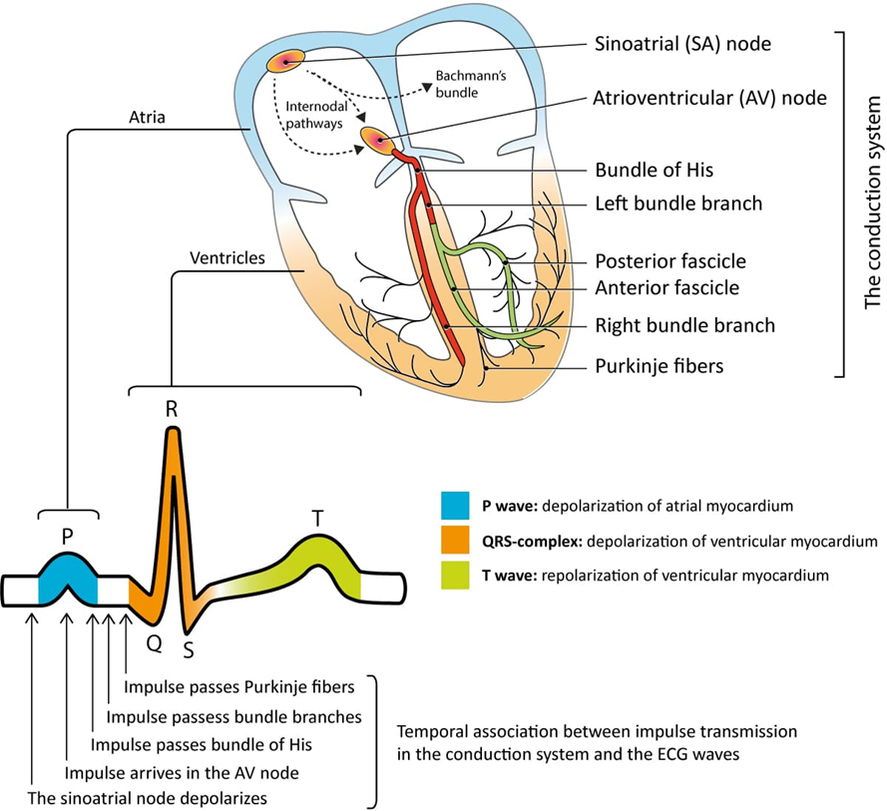
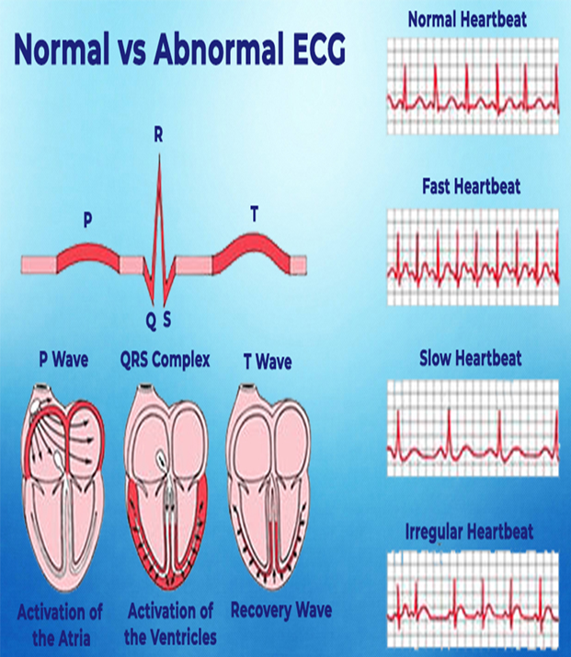
Modern technology to detect heart diseases Electrocardiography (ECG)

Slide 43
Electrocardiography (ECG) is a quick and easily accessible method for diagnosis and screening of cardiovascular diseases including heart failure (HF). Artificial intelligence (AI) can be used for semi-automated ECG analysis. The aim of this evaluation was to provide an overview of AI use in HF detection from ECG signals and to perform a meta-analysis of available studies.
Evaluation of symptoms suggestive of HF currently demands physicians to valuate various parameters including imaging and laboratory data and the electrocardiogram (ECG). Besides a standard examination that includes an ECG, imaging information, such as echocardiography or magnetic resonance imaging, is seen as gold standard in diagnosis of HF. Nevertheless, an adequate use of such imaging data is associated with relevant technical infrastructure and medical expertise. The ECG is a well-established, quick, and easily accessible method for diagnosis and screening of various cardiovascular diseases. It provides specific features that indicate presence of HF or prognosis in HF patients especially to rule out HF in case of a normal ECG. However, use of an ECG as primary diagnostic instrument often only yields insufficient diagnostic specificity. Further, general practitioner–based ECG reporting has varying results, introducing further diagnostic uncertainty

Slide 44
Devices providing medically relevant information generated directly by individuals outside the healthcare system such as smartphones with health applications or wearables including smartwatches are an emerging trend. This development promises that a growing number of, e.g., ECG data generated at home will be available for a diagnostic screening. Such data have already shown potential in computer-aided decision support systems to warn patients of rhythmic abnormalities.
Management of this quantity of data, however, might be a challenge for the individual healthcare professional, as well as for the healthcare system itself. The potentially beneficial use of artificial intelligence (AI) in cardiology in general has been discussed already, e.g., as a tool for clinicians that could facilitate precision in daily practice and even might improve patient outcomes. AI might also be able to help in interpretation of ECG signals and could therefore be used to analyze ECG data in specific cases and on a large scale for early identification of cardiovascular diseases such as HF.
Reference : https://youtu.be/RYZ4daFwMa8

